Slide 1
0x208 – AES Modes
ECED4406 – Computer Security
Dr. Colin O’Flynn
Dalhousie University.

Slide 2
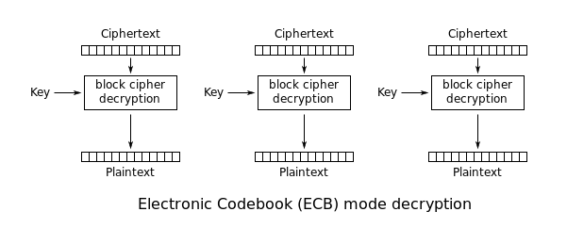

Slide 3


Applying AES-ECB to a Message
AES-ECB

Slide 4
What happened??
The same data always encrypts to the same data.
Overall structure (in this case an image) remains.
ECB alone provides little security – if someone figures out what one block means once, it’s game over!

Slide 5

Accomplishing an expected image encryption.
AES-???

Slide 6
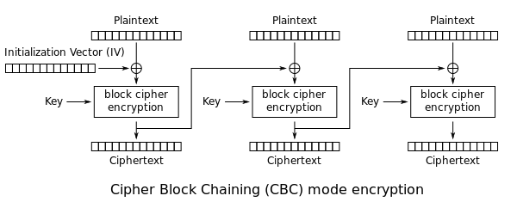
Cipher Block Chaining (CBC)

Slide 7
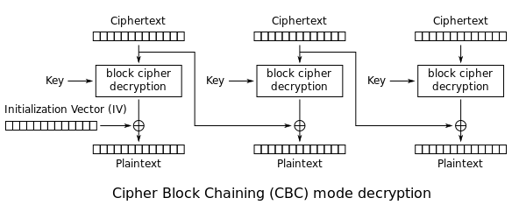
AES-CBC Mode Usage
In AES-CBC, a random Initialization Vector (IV) is used, which is normally not a secret. The IV must be given to the decryption algorithm.
AES-CBC depends on previous ciphertext (cannot decrypt arbitrary blocks without previous block access).
AES-CBC in decryption is vulnerable to bit flipping attack:

Slide 8
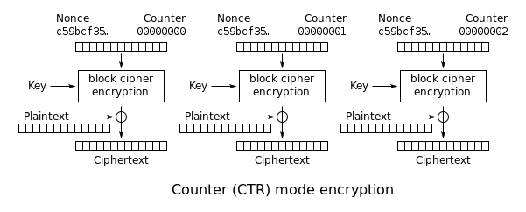
Counter Mode

Slide 9
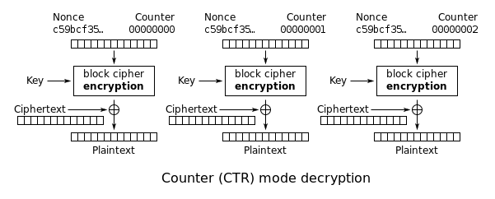
Counter Decryption – Same Thing

Slide 10
Counter Mode I.V.?
Note the addition of a Nonce – Number Used Once
What happens if Nonce is re-used?

Slide 11
Counter Mode as Stream Cipher
You can notice that the counter mode effectively generates a keystream based on our encryption key, the nonce, and the counter.
If the nonce is reused to encryption different data, the keystream will be the same.
If an attacker has known ciphertext & plaintext they could recover the keystream, and thus use the known keystream to attack a situation where they have unknown plaintext.

Slide 12
Nonce Reuse Warning (Cont’d)
Simple example:
Imagine you use AES-CTR mode in a communications interface.
Every message re-uses the nonce, such the same keystream is generated.
Attacker forces a “known” message (such as sending a query to the device).
Attacker records the “ciphertext”.
Attacker performs “message XOR ciphertext” to recover keystream.
Attacker then records unknown messages, and decrypts it with known keystream.

Slide 13
AES-CTR Mode Usage
AES-CTR mode relies on a simple structure.
Provided nonce reuse can be enforced it is a good choice.
AES-CTR mode can decrypt arbitrary blocks, as just need to provide the counter input.

Slide 14
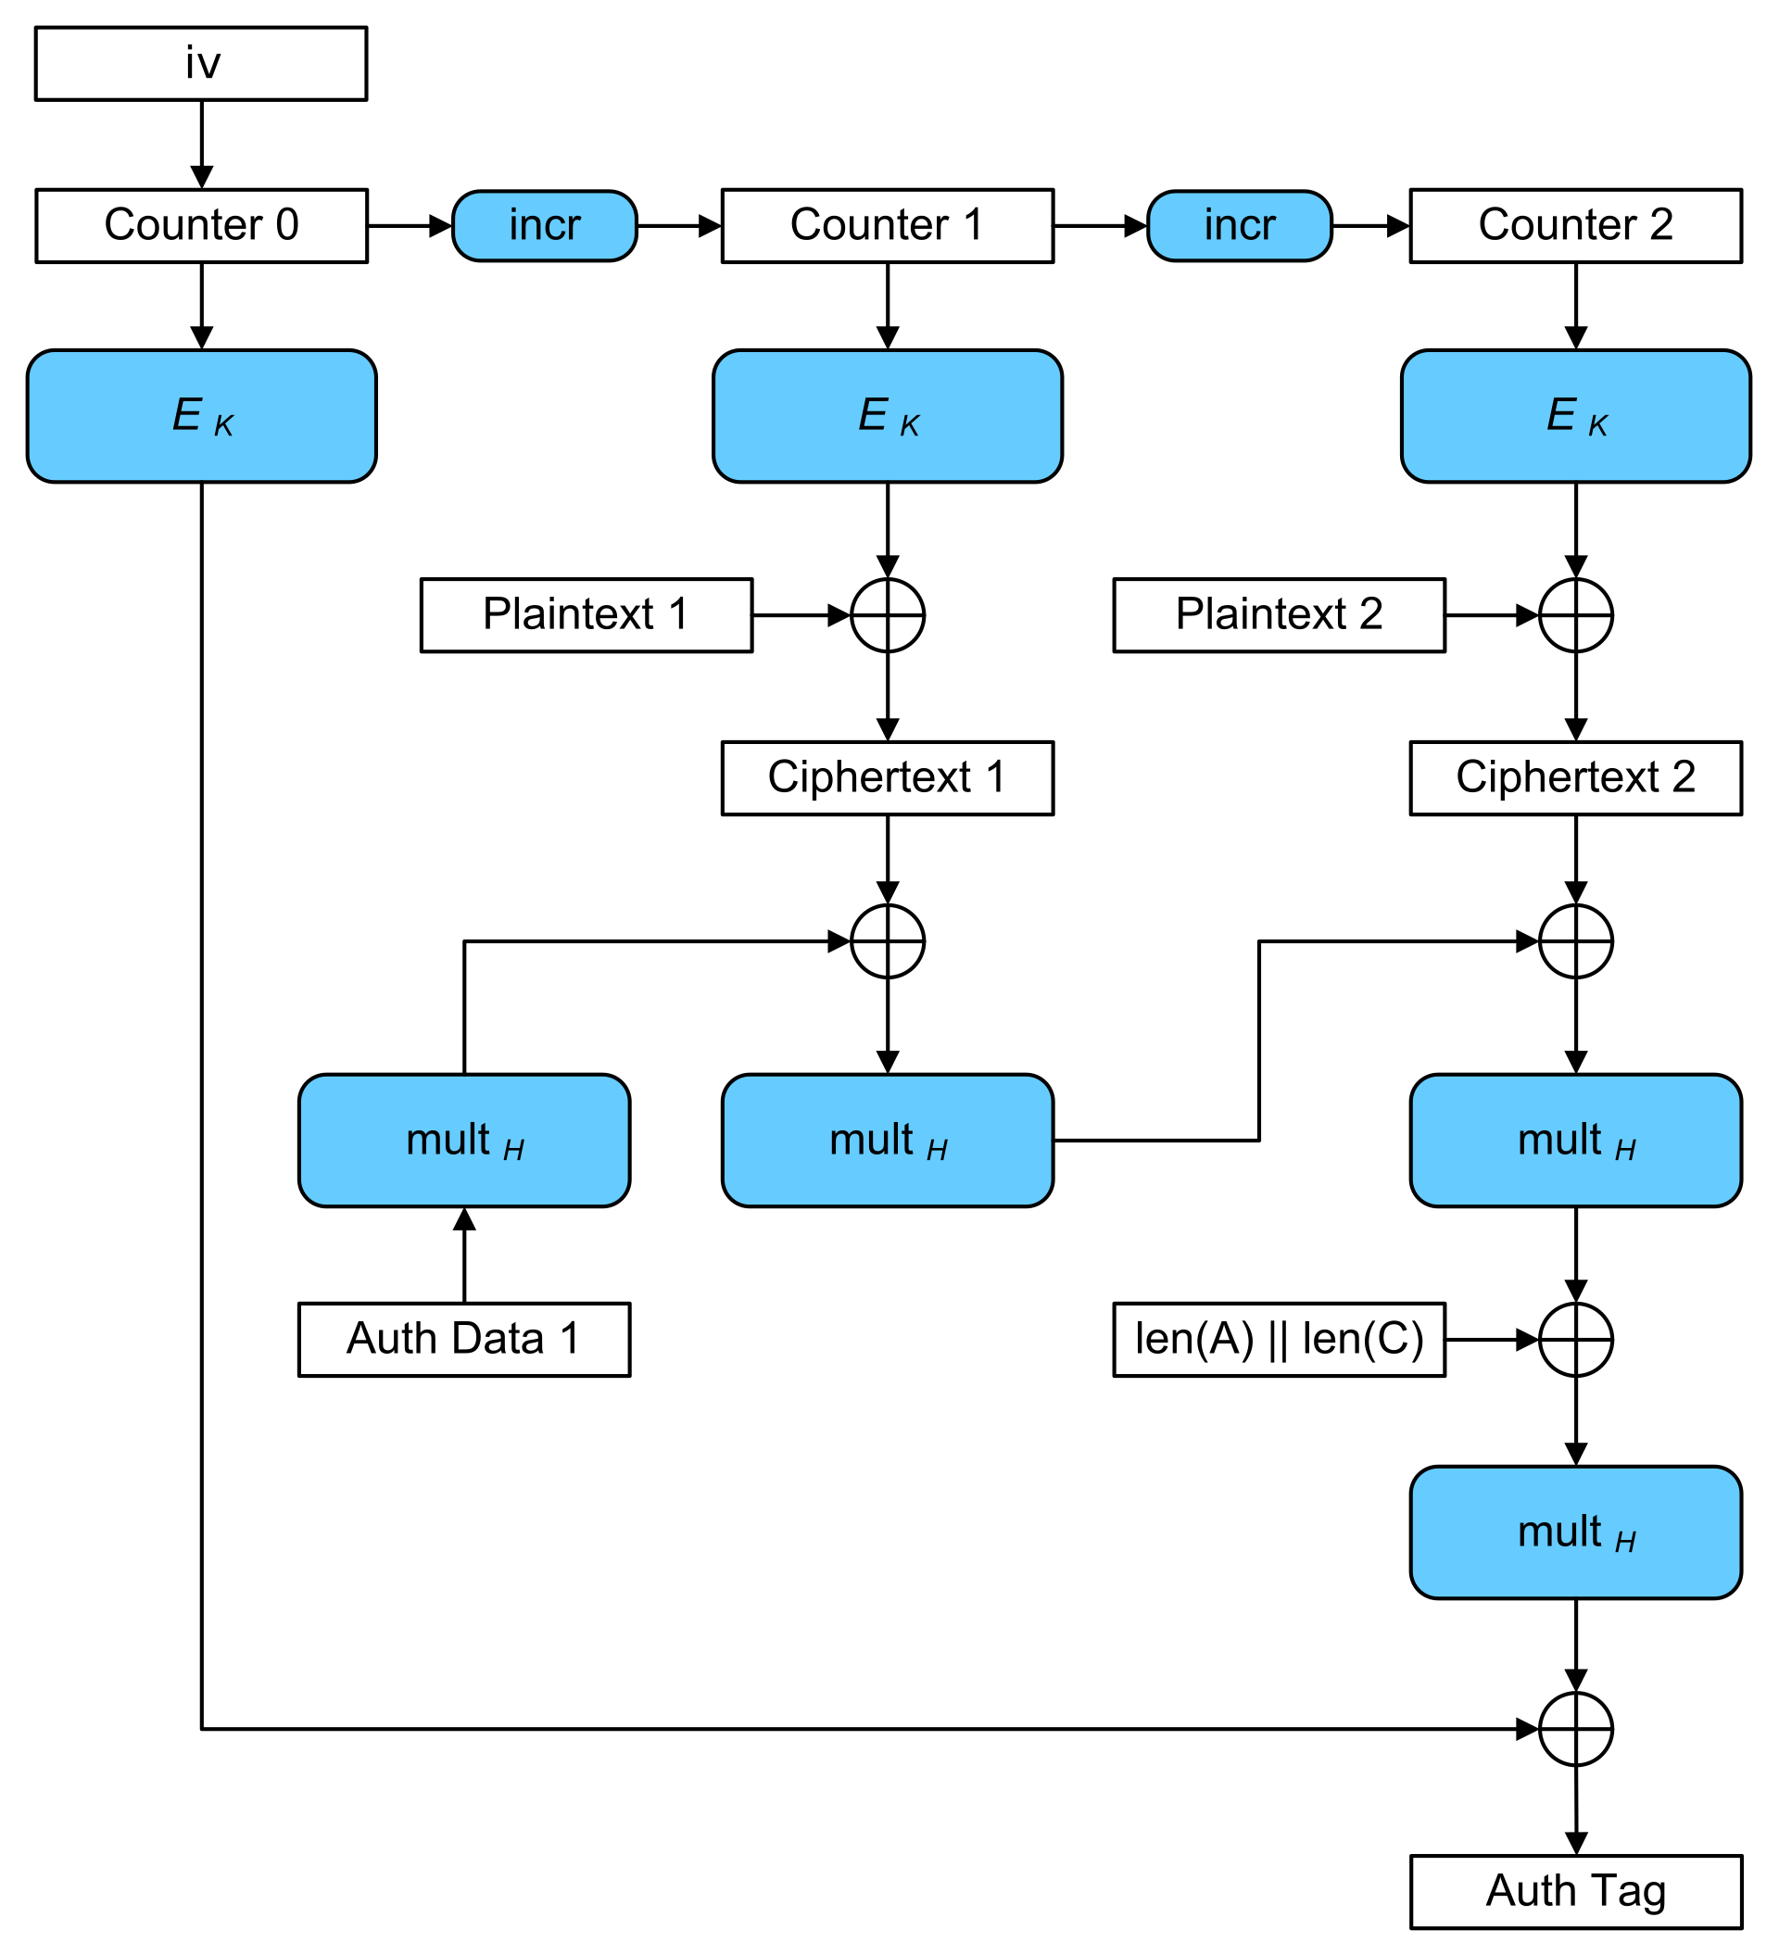
Galois/Counter Mode (GCM)
https://en.wikipedia.org/wiki/Galois/Counter_Mode#/media/File:GCM-Galois_Counter_Mode_with_IV.svg

Slide 15
AES-GCM Usage
AES-GCM performs encryption/decryption as in AES-CTR
Adds an additional authentication tag that allows us to ensure data was not modified (such as bit flipping in ciphertext).
AES-GCM has become more popular in device usage.

Slide 16
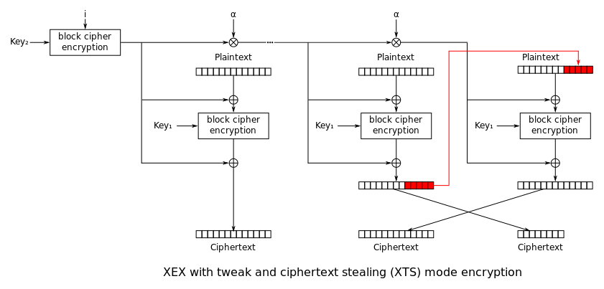
Xor Encrypt Xor (XEX)-based Tweaked-Codebook mode with Ciphertext Stealing (XTS)

Slide 17
AES-XTS Usage
AES-XTS is used in hard drive encryption.
Input is normally a second being encrypted/decrypted, along with the data.
Designed to easily allow usage where the size of the data being encrypted/decrypted does not match the AES block size.

Slide 18
AES Mode Summary
Several AES modes that you can use.
AES-ECB should not be used to encrypt large blocks of data!
Suitable mode depends on your usage requirements.

